Slide 1



OFFICE SUPPLY SALES REPORT FOR S.O COMPANY
BY : abiola Ogunbajo

Slide 2
Executive summary
This report gives an overview of the segment, state and product sold between January and December 2014, showing numbers of sales, sales proportion and financial performances.
This analysis was made to determine the growth or decline of any of the product lines which compares the 2013 q4 and 2014 q4 figures to highlight the year result and reproduced the report to higher levels such as product category and state.
This report shows the key products that are the drivers of performance, products that need to be discontinued due to poor performance and the tax being paid on each product overall, products in each state and products in each segment.

Slide 3
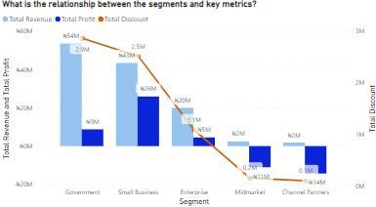
Key findings
SEGMENT
The Segment Report Overview shows the relationship between each segment and the key metrics i.e., Profit, Revenue and Discount.
The Government segment generated the highest revenue of N54M with a discount of N2.9M. The total profit made is N9M.
The Small Business segment made the highest profit of N26M.
The Midmarket segment and Channel Partners segment generated the least revenue and losses. The former made N2M revenue and N11M loss while the latter made N2M revenue and N14M loss.
The segments with high revenues and profits have the most discount while the segments with the least revenue and losses have the least discounts.

Slide 4
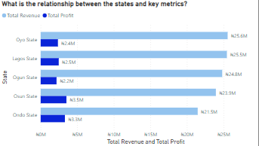
KEY FINDINGS
STATES
The States Report Overview shows the relationship between each state and the key metrics i.e., Profit and Revenue.
The highest revenue (N25.6M) was generated in Oyo State.
The lowest revenue (N21.5M) was generated in Ondo State.
Osun State is the most profitable state with a profit of N3.5M.
The least profit of N2.2M was made in Ogun State.

Slide 5
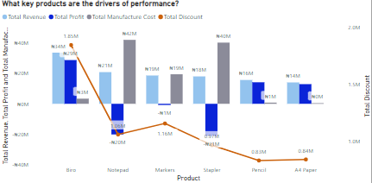
Key findings
PRODUCTS
The Products Report Overview shows the relationship between each product and the key metrics i.e., Profit, Revenue, Manufacturing Cost and Discount.
We generated the highest revenue of N54M on Biro and the least revenue of N14M on A4Paper.
Biro is our most profitable product with a profit of N29M. Followed by, Pencil and A4 Paper with profits of N14M and N13M respectively.
Our least profitable products are Markers, Notepad and Stapler which generate losses of N1M, N20M and N21M respectively.
The manufacturing costs of the products generating losses are the highest. Notepad, Markers and Stapler have N42M, N19M, and N40M manufacture costs respectively.
From this analysis, it can be inferred that Biro, Pencil and A4 Paper are the drivers of performance.

Slide 6
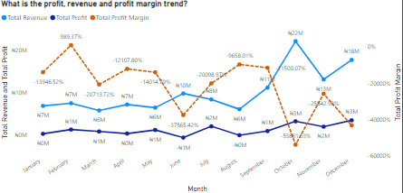
KEY FINDINGS
Overall,
We generated the most revenue (N22M) in October and the least revenue in May and August (N6M).
Our most profitable months are October and December with profits of N3M and N3M respectively.

Slide 7
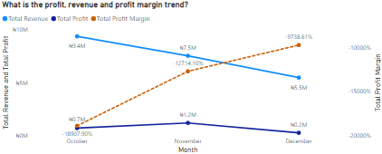
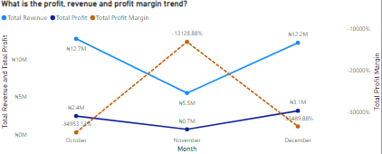
KEY FINDINGS
2013 Q4
2014 Q4
In 2013 Q4, there was a slight increase in profit from October to November, then a decline from November to December (71.42%). In 2014 Q4, there was a decline in profit from October to November, followed by, an increase in profit from November to December (29.17% growth rate).
In 2013 Q4, there was a decrease in revenue from October to December (41.48% decline rate). In 2014 Q4, there was a decline in revenue from October to November, followed by, an increase in revenue from November to December (3.93% decline rate).

Slide 8
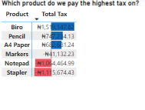
Key findings
The visual report below shows how much tax is being paid on each product.
The highest tax is being paid on Biro, overall.

Slide 9
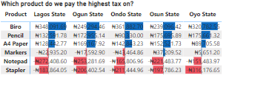
KEY FINDINGS
The visual report below shows how much tax is being paid on each product in different states.
In Lagos State, we pay the highest tax of N348,091.69K on Biro.
In Ogun State, we pay the highest tax of N249,294.46K on Biro.
In Ondo State, we pay the highest tax of N361,882.70K on Biro.
In Osun State, we pay the highest tax of N239,096.42K on Biro.
In Oyo State, we pay the highest tax of N320,782.55K on Biro.

Slide 10
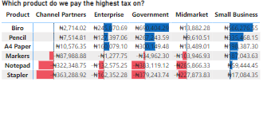
KEY FINDINGS
The visual report below shows how much tax is being paid on each product for different segments.
For the Channel Partners segment, we pay the highest tax of N10,576.35K on A4 Paper.
For the Enterprise segment, we pay the highest tax of N245,870.69K on Biro.
For the Government segment, we pay the highest tax of N690,404.29K on Biro
For the Midmarket segment, we pay the highest tax of N13,882.28K on Biro.
For the Small Business segment, we pay the highest tax of N566,276.55K on Biro.

Slide 11
RECOMMENDATIONS
Stapler and Notepad should be discontinued due to poor performance and high manufacture costs.
The Midmarket segment and Channel Partners segment generated the least revenue. Further investigations need to be made in these segments to determine their poor performance.
More investments should be made on A4 paper because it also has prominence to become a driver of performance as well.

Slide 12
CONCLUSIONS
S.O company’s growth is stable but there is a need to cut down the rate of unnecessary expenditure and invest more in the key performance drivers.
The company should also focus on products with low performance and make improvements to enable positive development in our company.

